Slide 1
Generative AI
Trends for 2024
Notes:
Thanks for joining us to talk about Generative AI trends for 2024

Slide 2


Today’s Speakers
Alexander Wurm
Samuel Hamway
Senior Analyst
Research Analyst
Notes:
I’m Alex Wurm, lead analyst at Nucleus Research for all things analytics and data management
[Sam Introduction]

Slide 3
Agenda
Trends in Generative AI
Challenges and limitations of current approaches
Best Practices for Organizations in 2024
Notes:
I know we have heard a lot about generative AI a lot so we will try to focus this presentation on the actual value organizations have achieved with generative AI.
.This includes:
Emerging trends and how they align with the value of generative AI
The challenges organizations should look out for
and the best practices organizations should keep in mind

Slide 4

Trends
Notes:
First, the trends
We are breaking out of the initial experimentation phase and certain use cases have emerged for their ability to deliver value.
As such, customer priorities have shifted.

Slide 5


Top Priorities for Gen AI
Time to Value Risk Mitigation
Notes:
Now the top priority for organizations isn’t how to best experiment and iterate on ideas but how to quickly and securely implement use cases of high value.
Technical experts are emerging.
Tools capable of shortening time to live are also proliferating.
These all change the ROI dynamics of many Gen AI use cases
Organizations must also consider the risks they are undertaking when delivering AI applications.
Evolving regulations
Ex. Europe regulating AI risks
Ex. bias audits
Future-proofing deployments
Technology infrastructure

Slide 6

The focus on value
Start with the simplest approaches and target the more exotic ones afterward.
General path (simplest to hardest)
- In-app capabilities -> bolster NLP -> RAG
Notes:
Balancing this value with risk, a clear path has emerged for organizations looking to achieve value generally following simplicity and speed of deployment.
In general, to achieve the greatest return, we recommend that organizations start with the most common use cases using the simplest method
This starts with leveraging AI capabilities delivered by vendors an organization already works with.
This can eliminate lengthy development cycles and minimize administrative costs over time.
this approach also offers a low risk profile as organizations don’t have to worry about the development and data management challenges involved in building out capabilities internally.
The next approach involved incorporating Gen AI services into existing NLP use cases,
often providing improved results with low additional cost or effort.
The last approach of emphasis is RAG which has garnered a lot of attention.
My colleague Sam will discuss the merits of RAG in further detail shortly.

Slide 7

Assessing the Value of Gen AI
Two important questions: 1) Where can I impact the most users?
2) What processes take up the most time?
Balance time to value with impact
Notes:
Now lets talk about how to identify high value use cases for Gen AI
For this, there are two important questions to ask yourself
What processes impact the most users?
What processes take up the most user time?
You might have a fantastic tool for generating code but if your organization has 10 developers and 100 sales associates, each time saving will have to be 10x greater to deliver the same value.
Instead, you might find that a tool summarizing sales opportunities would enhance user productivity more effectively
Organizations that effectively balance the value delivered and time to deploy are poised to archie the greatest returns.

Slide 8
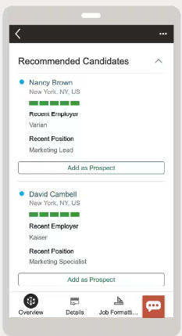
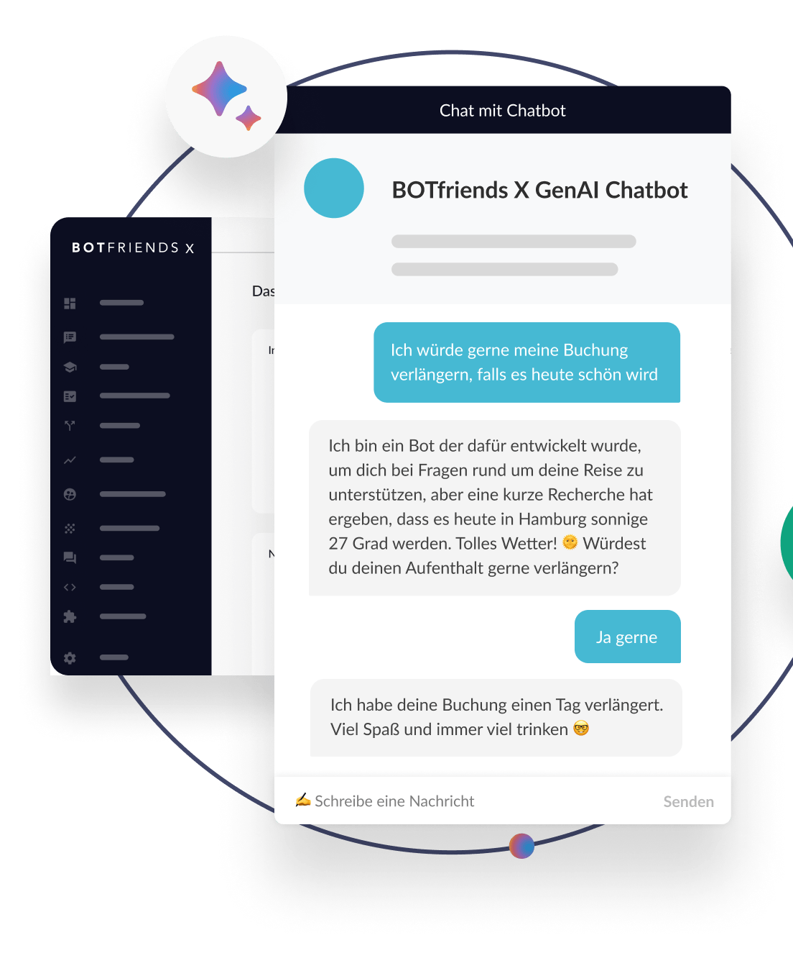
Proliferation of in-app capabilities
Before developing something from scratch check if an analogous capability is offered in an existing application or system.
Notes:
One of the areas driving the best value are generative AI capabilities delivered within enterprise applications.
As I discussed previously, this approach often delivers accelerated time to deployment with minimal risk providing the foundation for a solid return.
I’ve provided a few examples on this slide although im sure a wide variety of different tools come to mind.
Ex. CX platforms may offer a chatbot that already use a Generative API service
Ex. Auto-generate job descriptions and infer skill gaps and requirements (Fusion HCM)

Slide 9
Trend: The Rise of Multimodality
What is multimodality in generative AI? Understand and generate content in different data modes like text, images, and audio, not just one medium.
How can you explore multimodality?
Business users should explore chatbots like ChatGPT and Bard for their multimodal capabilities. They can improve productivity from their interfaces by automating customer service, aiding content creation, simplifying data analysis, and interpreting visual and textual data.

Slide 10
Multimodality example: customer service and support
Why It's Promising:
Enhanced Interaction: Integration of voice, text, and visual data for comprehensive customer understanding and personalization.
Practical Application:
AI-Powered Chatbots: Chatbots capable of processing and responding to text, voice, and visual cues.
Opportunities Ahead:
Customer Satisfaction: Potential for greatly enhanced customer satisfaction.
Cost Reduction: Significant reductions in operational costs through reallocation of rep FTEs
24/7 Service: Ability to provide continuous service.

Slide 11
Trend: The Continued Dominance of RAG
What is RAG? Retrieval-Augmented Generation (RAG) combines retrieval-based and generative NLP methodologies.
Why RAG? Organizations want to augment their AIs with internal knowledge.
How it Works:
Step 1: RAG starts by retrieving information from a dataset or knowledge base, often housed in a vector store database.
Step 2: The retrieved data forms the foundation or context for content generation or response formulation.

Slide 12

Rag: Example 1
Challenge: Streamlining legal research processes and providing accurate, context-relevant legal precedents and documents.

Slide 13
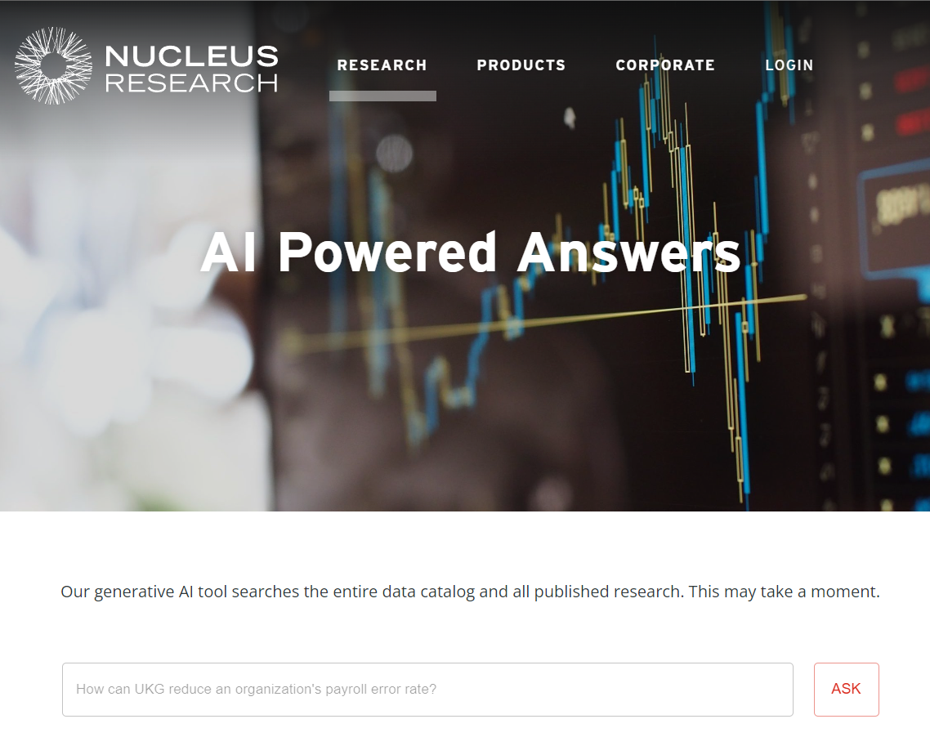
Rag: Example 2
Challenge: Asking a question across a collection of thousands of PDF reports, with the ability to answer questions using synthesized information across dozens of relevant documents.

Slide 14
Rag Process
RAG Implementation:
Step 1 - Retrieval:
The RAG system is programmed to access a vector database of documents and other unstructured data sources.
Upon receiving a query (e.g., "How much can organizations benefit from moving from on-prem to the cloud"), the system retrieves the n most relevant document fragments using vector search algorithms across the database.
Step 2 - Generation:
The retrieved information with the query serves as input for the generative AI model.
The language model then synthesizes this information, contextualizing it within the scope of the query to provide concise, relevant summaries or insights.

Slide 15
Rag benefits
Benefits and Outcomes:
Improved Operational Efficiency: Simplifies the tedious process professionals spend reading and synthesizing text data sources, enabling them to focus on analysis rather than data retrieval.
Increased Accuracy Compared to Models without a Knowledge Base: Provides highly relevant and context-specific information.

Slide 16

Challenges & Limitations

Slide 17
Limited Customizability of Pre-built AI apps
One-Size-Fits-All Solutions: Often, vendor-provided solutions may not fully align with unique enterprise needs.
Restricted Feature Set: Limited ability to modify or extend functionalities based on specific business requirements.

Slide 18
Scaling issues related to in-house applications
Scaling Challenges: Escalating demands can intensify operational complexities and strain enterprise infrastructure, particularly in computational power and storage needs.

Slide 19
Costs related to building in-house applications
High Computational Costs: Substantial expenses related to API fees and resource utilization.
Ongoing Maintenance Costs: Continuous financial commitment and sustained IT complexity for updates, data management, and maintenance.

Slide 20
Quality and Accuracy Concerns
Risk of 'Hallucination': AI may generate plausible but incorrect or nonsensical information.
Human Oversight Necessity: Importance of human evaluation in critical decision-making processes.

Slide 21

Best Practices

Slide 22
Best Practice: Start with existing NLP when building own
Start Small With Existing NLP Processes: Before diving into complex LLM deployments, assess your existing NLP processes to identify areas for improvement. Determine where the advanced capabilities of LLMs can add value over traditional NLP techniques, such as TF-IDF and sentiment analysis.
Example – More advanced sentiment analysis: If your business uses traditional sentiment analysis for social media monitoring, LLMs can provide a more advanced analysis. Traditional methods might struggle with nuances like sarcasm, mixed emotions, or context-dependent sentiments.
.

Slide 23
Best Practice: Maintain Interoperability when building own
Ensure the architecture of generative AI applications allows for the swapping of models, vector databases, and other components. Given the rapid growth and changes in this space, building for interoperability enables the integration of new best-of-breed solutions as they emerge, keeping your applications at the forefront of technological advancements.

Slide 24
Work with departments and teams to identify new use cases
Each line of business is producing many ideas for Gen AI use cases.
Internally
Summarizing opportunities in sales teams
Narrative reporting for analytics teams
Resume parsing and skill classification for HR teams
Externally
Customer support and interaction
Unstructured search
Notes:
Even though we are out of the initial experimentation phase, we recommend that organizations continually brainstorm potential use cases.
In particular we recommend that organizations assign each department or business unit with coming up with a few relevant to their line of work
very shortly you will have a long list
Internally this may look like
Summarizing opportunities in sales teams
Narrative reporting for analytics teams
Resume parsing and skill classification for HR teams
Externally you may also find ways to impact customers
Support and customer interaction
Unstructured search to better position capabilities, offerings, and documentation

Slide 25
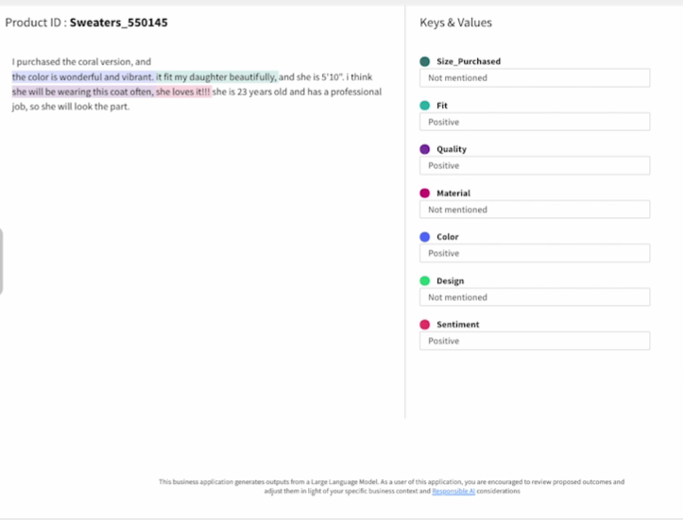
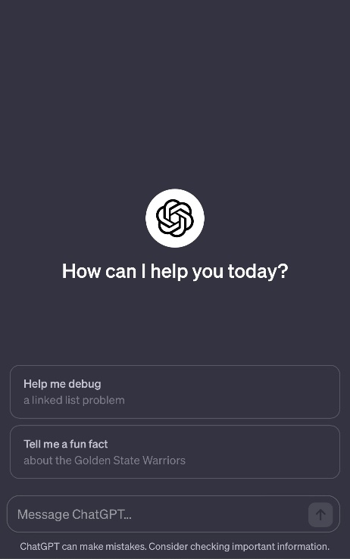
Prioritize Established Use-Cases in building Gen AI Applications
Structure
Generate
Retrieve
Notes:
After this brainstorming exercise, you should be able to assess the potential of each use case focusing on applications that have already proven successful
In general, 3 application classes have emerged
Structuring unstructured data
A great example involves Sentiment analysis of text to get a better understanding of users (internally for HR flight risks) (externally for social media and customer sentiment)
Generating content
This is the most familiar use case for most people and is the core of ChatGPT
For any developers in the audience, a key use case has emerged around generating code documentation, saving considerable time.
Retrieving content
to better position existing capabilities, offerings, and documentation

Slide 26

Establish LLMOps
Components of LLMOps:
Model evaluation
A/B Testing
User feedback
Deployment and monitoring
Observing model updates
API monitoring
Experiment tracking
Drift Monitoring
Feature importance
Model Fairness
Notes:
We also recommend that organizations incorporate LLMOps into their core Data and MLOp practices, especially as use cases proliferate
Gen AI application delivered need to be constantly evaluated
This involves AB testing relative to other models
Collecting feedback to refine the user experience
Deployment Monitoring and ongoing monitoring
Model updates
API monitoring
Drift monitoring
Feature importance and model fairness evaluation

Slide 27


Thank you
For more, visit NucleusResearch.com.
Notes:
Thank you.
Questions?

